Slide 1

CountMeIn Introdução à Engenharia de software
Joaquim Rosa 109089
Hugo Correia 108215
Alexandre Cotorobai 107849
Bernardo Figueiredo 108073

Slide 2
Team and Roles
Architect
DevOps
Team Manager
Product Owner
Alexandre Cotorobai
Responsible for task distribution, meeting deadlines and orienting the team in the right direction
Hugo
Correia
Represents the main interests of the stakeholders and clarifies the project features/requirements
Joaquim Rosa
Deep understanding of the proposed architecture and supporting technologies.
Bernardo Figueiredo
Responsible for the infrastructure and its configuration

Slide 3
Product Concept
CountMeIn is a space management service designed for businesses looking to optimize customer flow and floor space usage. It combines real-time data from cameras with an autonomous door system and graphical displays for instant feedback. The service includes an online platform for custom settings and a private API for seamless integration with client platforms.

Slide 4
Project Objectives
Space Optimization
User Interactivity
Maximise utilisation of limited spaces by managing real-time occupancy
Provide a local graphical interface that displays updated information on room occupancy and capacity
Integration and Combatibility
System Performance
Ensure seamless integration with existing security and monitoring infrastructures and external systems via private API
Maintain efficient real-time data processing for timely updates on occupancy status, ensuring high availability and fault tolerance

Slide 5
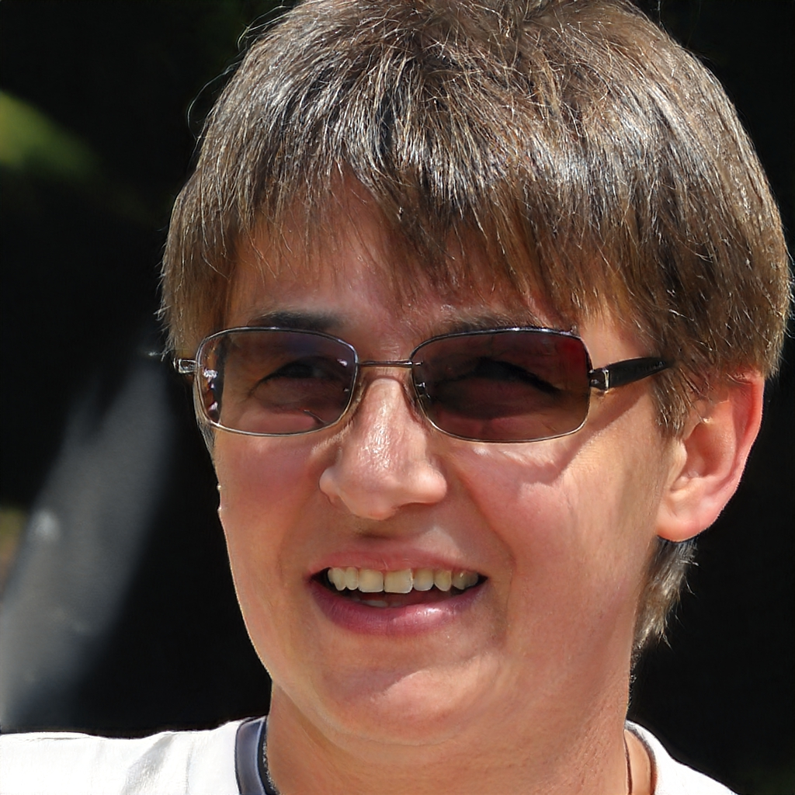

Personas
Demographics:
Age: 52
Role: Library Administrator
Motivations: Committed to creating an organised and inviting library atmosphere, values the CountMeIn system for managing occupancy and maintaining an optimal study environment.
Dona Celeste
Demographics:
Age: 22
Role: Software Engineering
Motivations: Sofia is driven by her ambition to excel in software engineering. She values a study space that minimises distractions and maximises her productivity. Tools and services that can streamline her study sessions and enhance her focus are essential to her daily academic routine.
Sofia

Slide 6
User Storys
14/20
Space Optimization for Enhanced Student Experience
Local Occupancy Display Check
As a library patron,
I want to be able to check the library's space occupancy through a local display at the entrance,
So that I can immediately know if there is available space for me to use.
Real-Time Data Monitoring and Visualization for Admins
As the library administrator,
I want to utilize the CountMeIn system to adjust room capacities,
So that I can manage space more effectively and enhance the study experience for students.
As an administrator of the CountMeIn system,
I want to monitor and visualize real-time data for each room I manage,
So that I can have an informed overview of occupancy trends and make data-driven decisions to optimize space utilization.

Slide 7
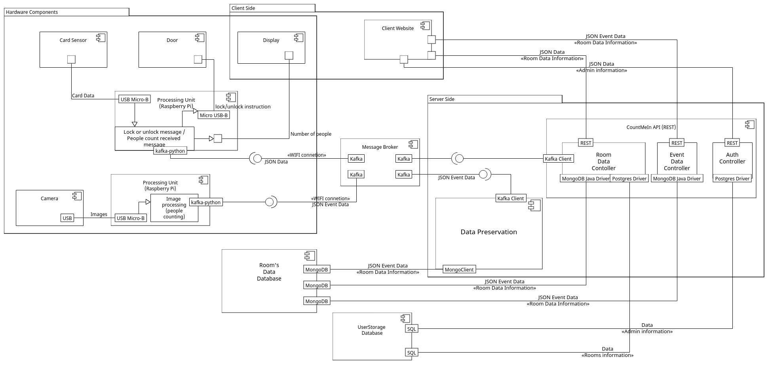
Architecture

Slide 8
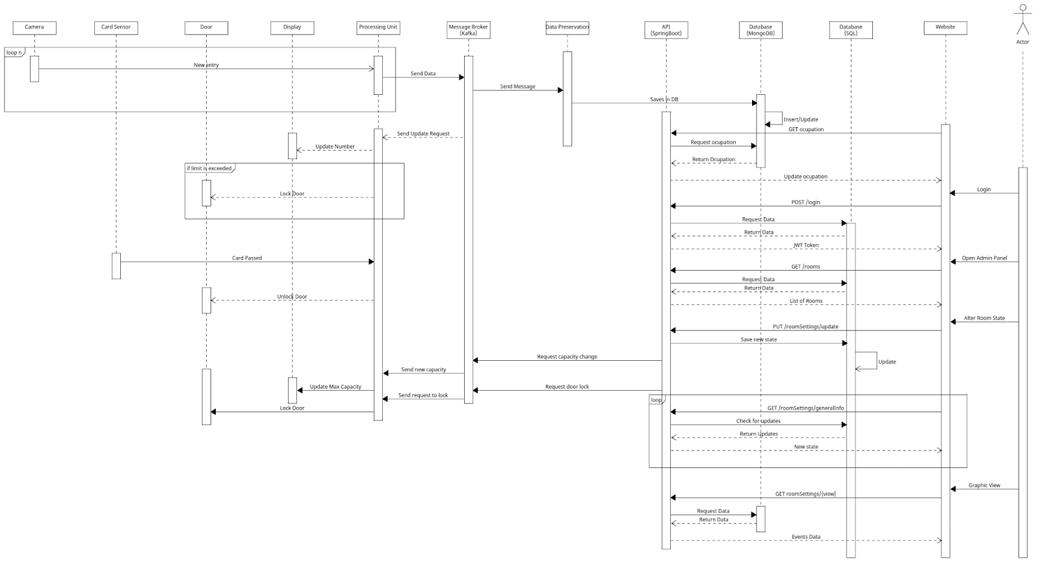
Module Interact

Slide 9
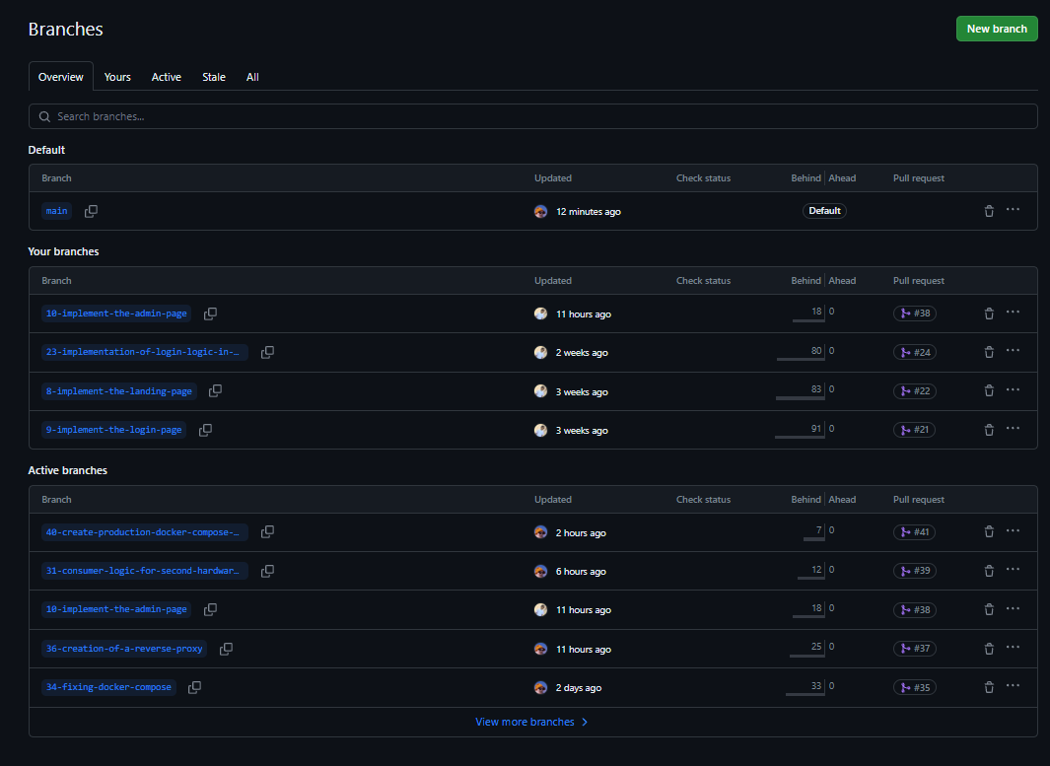
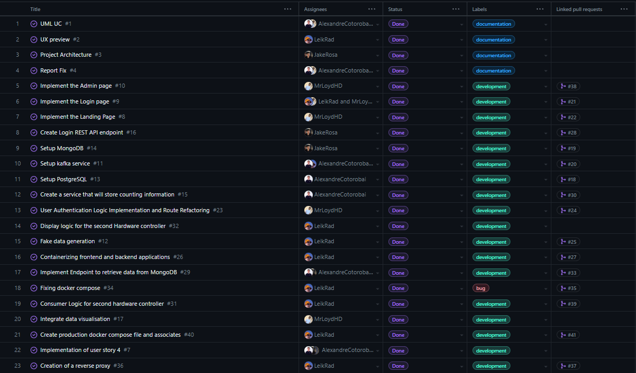
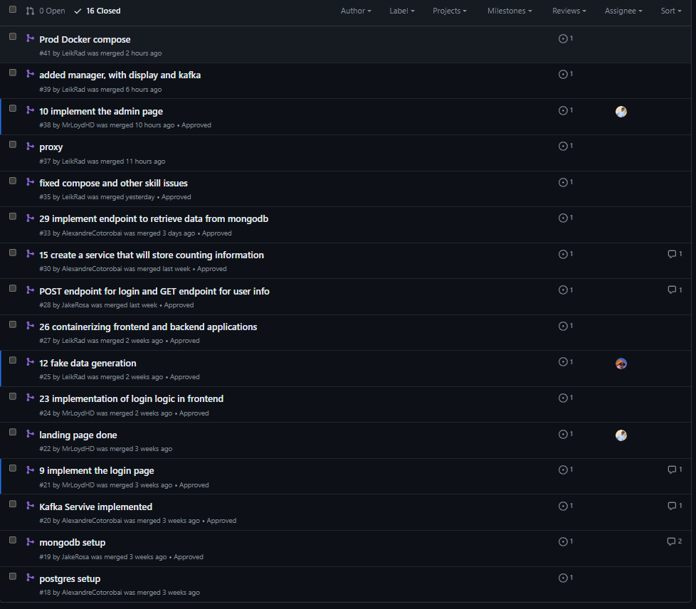
Project Managment

Slide 10
DEMO

